Slide 1
Tensorflow basics – part 2
Prof. Yong Won SEO, Ph.D.
College of Business and Economics
Chung-Ang University

Slide 2

Simple Linear Regression
Given with real (x, y) data, find best a, b for:
$$\hat{y}=ax+b$$
adCost | sales
30 | 120
20 | 60
50 | 140
40 | 100
10 | 70

Slide 3
Minimize sum of squares of deviations

Slide 4
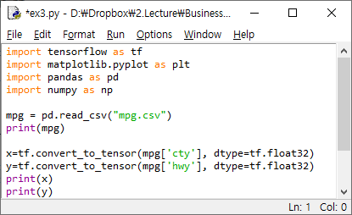

Slide 5
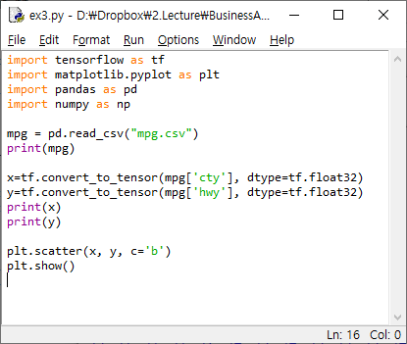

Slide 6
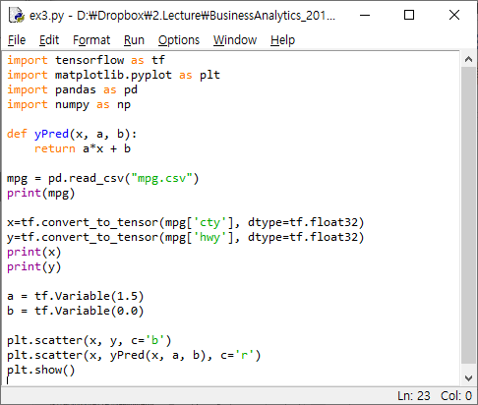
y=1.5x?

Slide 7
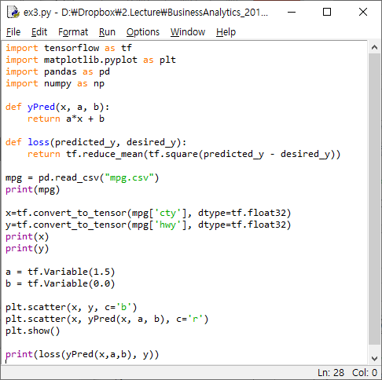
How much error for y=1.5x?

Slide 8
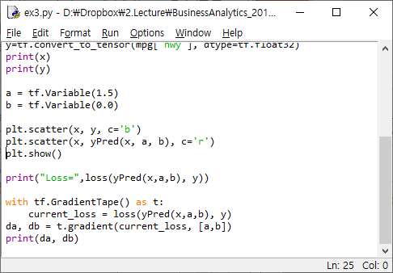
Gradient! (da=68.18, db=3.697)

Slide 9
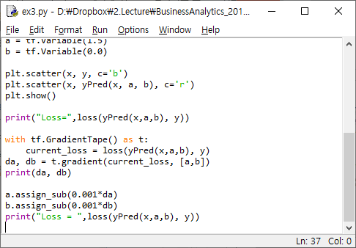
Decrease a, b (because gradients > 0) - gets better?

Slide 10
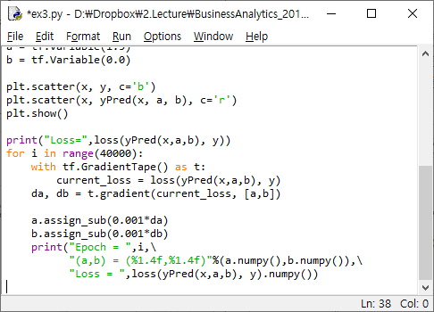
Repeat!

